Slide 1
Conversation toxicity detection
Proyecto 3 – Minería de Datos
Presentado por:
Ricardo Andrés Marín
Fredy Orlando Muñoz
Edgar David Contreras
Juan Camilo Angarita

Slide 2
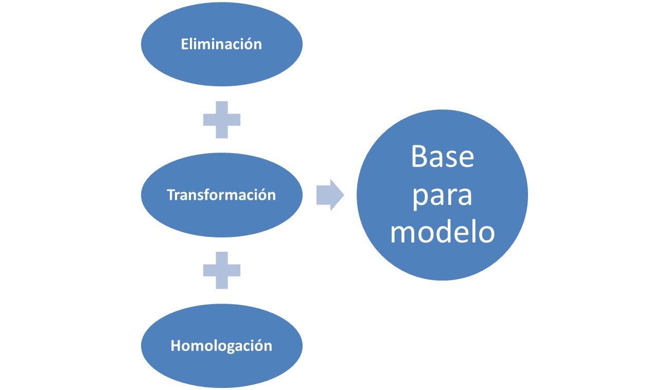
Se hacen tres procesos preliminares…

Slide 3
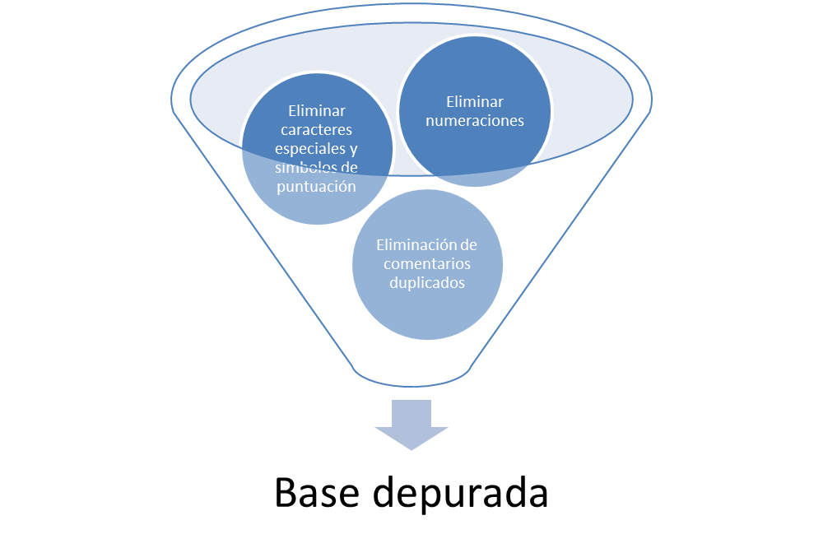
A nivel de eliminación
It doesn't take all of my 150 IQ to see the slan
It doesn't take all of my IQ to see the slant

Slide 4
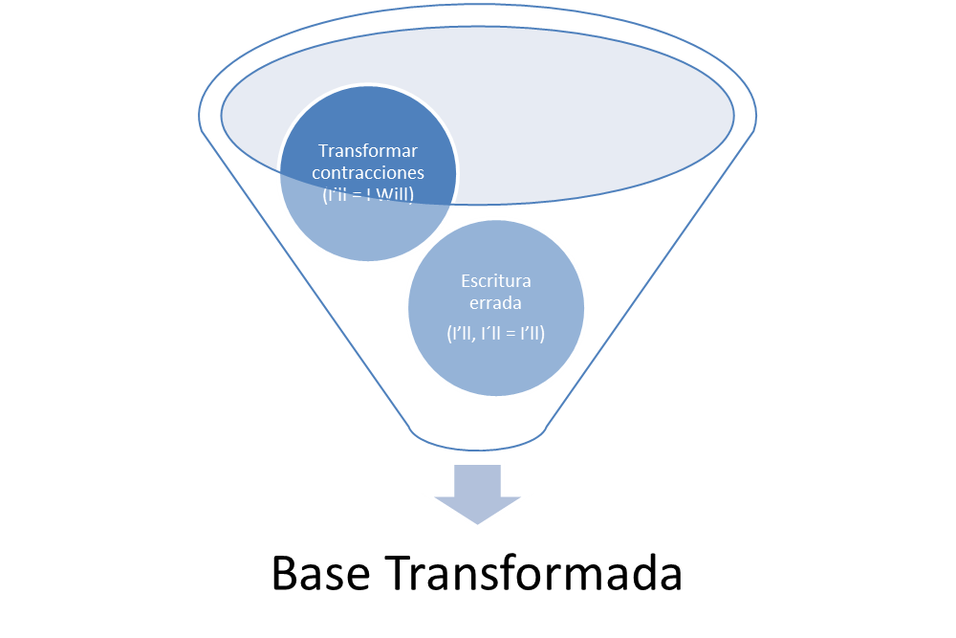
A nivel de transformación…
This is so cool. It's like, 'would you want your mother to read this??
This is so cool. It is like, 'would you want your mother to read this??

Slide 5
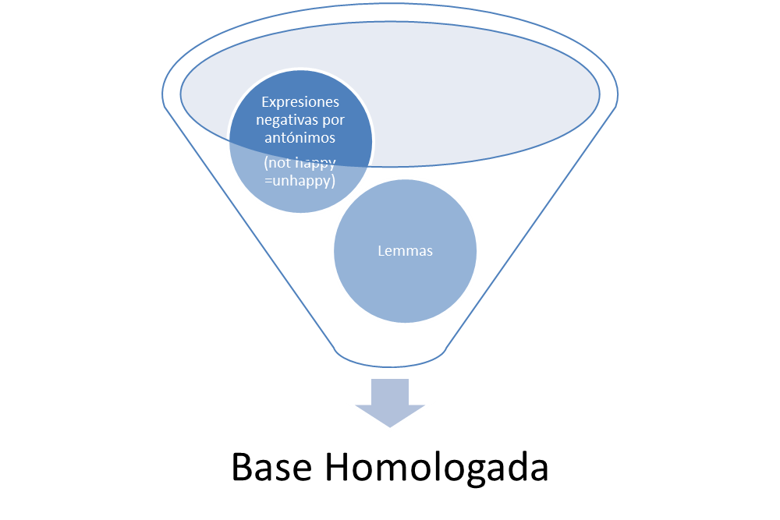
A nivel de homologación…
Keep it up, and don't let anyone get in your way!
Keep it up , and do not let anyone get in your way !
haha you guys are a bunch of losers
haha you guy are a bunch of loser

Slide 6
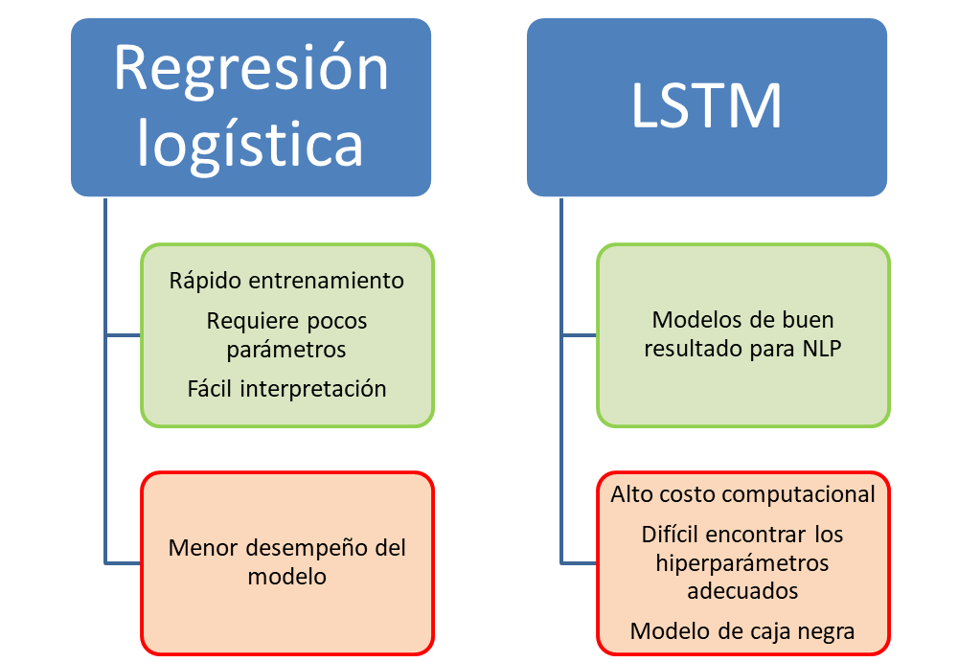
Respecto al modelamiento se emplearon dos caminos…
ROC:
0,891
0,903

